Slide 1
A fully distributed hierarchical attribute-based encryption scheme
Mohammad Ali , Javad Mohajeri , Mohammad-Reza Sadeghi , Ximeng Liu

Slide 2
abstract
With the development of cloud computing, many enterprises have been interested in outsourcing their data to cloud servers to decrease IT costs and rise capabilities of provided services.
To afford confidentiality and fine-grained data access control, attribute-based encryption (ABE) was proposed and used in several cloud storage systems.

Slide 3
Attribute-Based Encryption(ABE)
實現1對多加解密 :
ABE不需要像其他加密方式那樣，每次加密都必須知道接受者的身份信息，當用戶擁有的屬性符合加密者所描述的policy時，用戶就可以解密。
ABE scheme 中包含了 attribute 和 access control policy

Slide 4
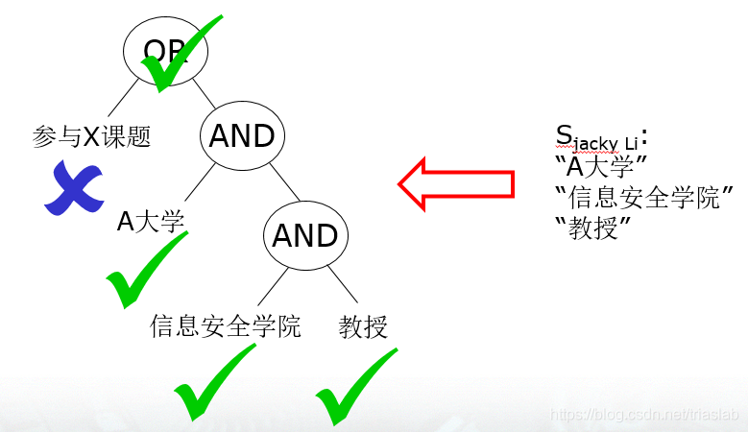
access control policy & attribute

Slide 5
key-policy ABE (KP-ABE)& ciphertext-policy ABE(CP-ABE)
KP-ABE :
secret-keys of a user is associated with an access control policy defined by the central authority, and ciphertexts are labeled with a set of descriptive attributes.
CP-ABE :
access control policies are defined by data owners and embedded in ciphertexts, and secret-keys of data users are associated with their attributes.

Slide 6
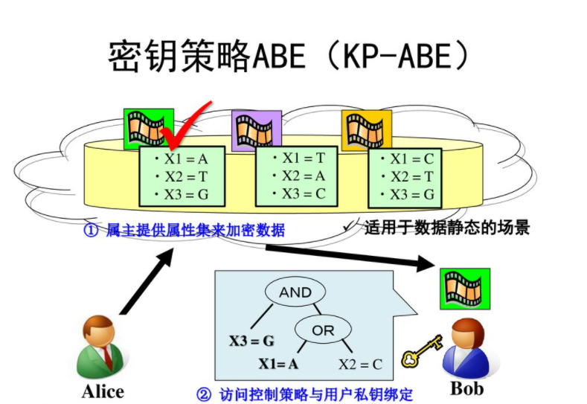
KP-ABE
A data user can decrypt a ciphertext only if its access control policy is satisfied
by attributes of the ciphertext.

Slide 7
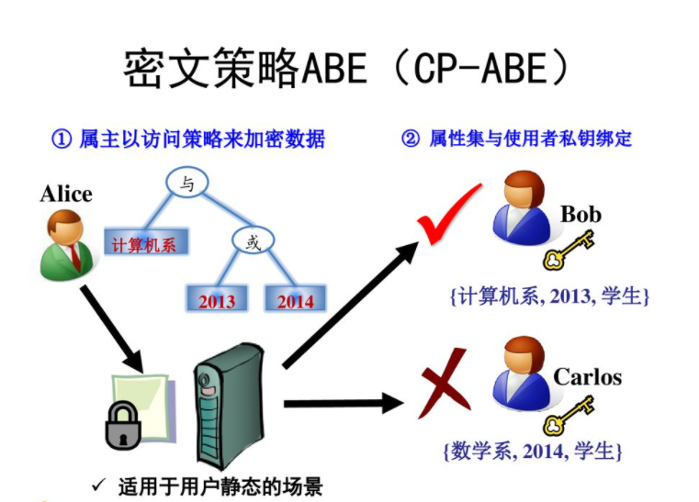
CP-ABE
A data user can decrypt a ciphertext only if the user’s attribute set satisfies the access
control policy associated with the ciphertext.

Slide 8
Disadvantage of CP-ABE
In a CP-ABE scheme, each user is specified by a set of descriptive attributes, and for each of the attributes, the user has to request the corresponding secret-key from a key generator authority.
So, traditional ABE systems with a single key generator authority seem not to be appropriate for large scale networks, and practical mechanisms for secret-key delegation and user revocation are required.

Slide 9
Hierarchical ABE (HABE) system
In a HABE system, there are several key generator servers that each of them are responsible for handling key delegation and user revocation associated with a specified set of attributes.

Slide 10
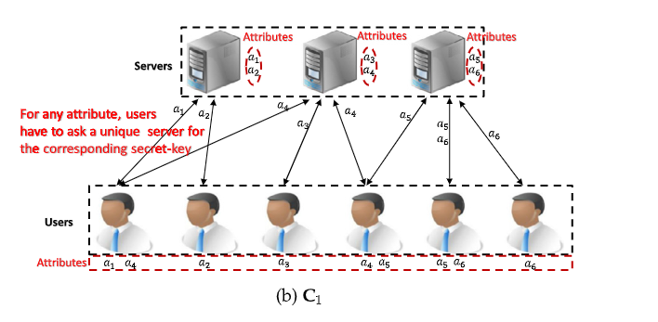
Categorie1:
For each attribute in the system, there is only one server to issue and revoke the secret-keys of users associated with the attribute.

Slide 11
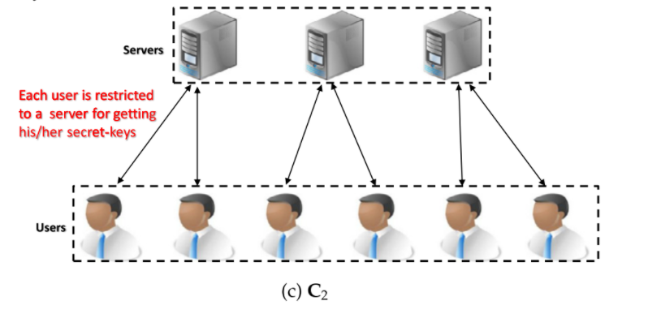
Categorie2:
For each user in the system, there is only one server to issue the users’ secret-keys.
Indeed the secret-keys gotten from different servers cannot be used together in the
decryption phase.

Slide 12
Problems
P1: If because of some technical issues, or worse, physical catastrophes such as an earthquake or a fire, one of the serves cannot work for a temporary period of time.
C1: the key delegation and user revocation services corresponding to the attributes associated with the server will be interrupted.
C2: the users associated with the server will be deprived of the services.
P2: In both of the categories, when the number of users requesting a server to generate their secret-keys is increased, because of the shortage of bandwidth and computational resources, the server may fail to provide the desired service.

Slide 13
Problems
P3: When the physical presence of users is required for obtaining the secret-keys.
C1: a user may have to visit several servers which may be time-consuming.
C2: if a user is far from the specified server, then obtaining the secret-keys is difficult for the user.

Slide 14
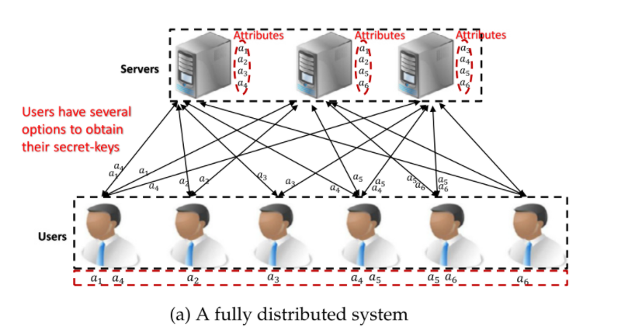
Fully distributed key delegation and user revocation mechanisms

Slide 15
Fully distributed key delegation and user revocation mechanisms
none of the attributes is restricted to a unique server, and each user has several options for obtaining his/her secret-key associated with an attribute.
users have several options for getting their secret-keys, and secret-keys gotten from different servers can be used together in the decryption procedure.

Slide 16
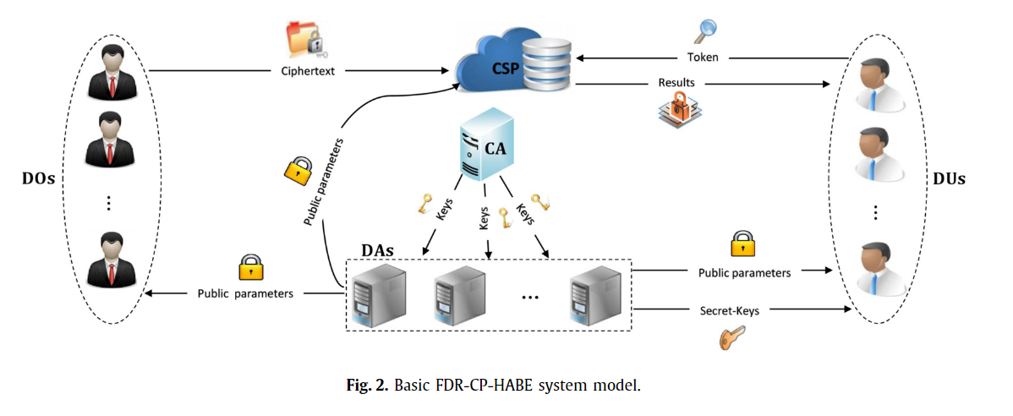
fully distributed revocable CP-HABE (FDR-CP-HABE) system

Slide 17
Revocable CP-HABE systems
Five types of entities:
Central Authority(CA): 他負責初始化系統的public parameters 和DAs的master secret-keys.
Multiple Domain Authorities(DAs):負責根據DUs的attributes生成secret-keys，並且在DUs失去了attributes時負責撤銷他們的存取權。
Cloud Service Provider(CSP): It provides storage, computation, and fine-grained access control services for DOs and DUs.
Data Owners (DOs): 所有的DO都會定義自己的access control policy, 並且會在定義的access policy下加密他的data，並將加密過後的data outsource 到 CSP.
Data Users (DUs): 每個DU都有a set of descriptive attributes.他們從DAs獲取和他們的attributes有關的secret-keys. 只有當他們的attribute set滿足ciphertext的access control policy時可以decrypt.

Slide 18
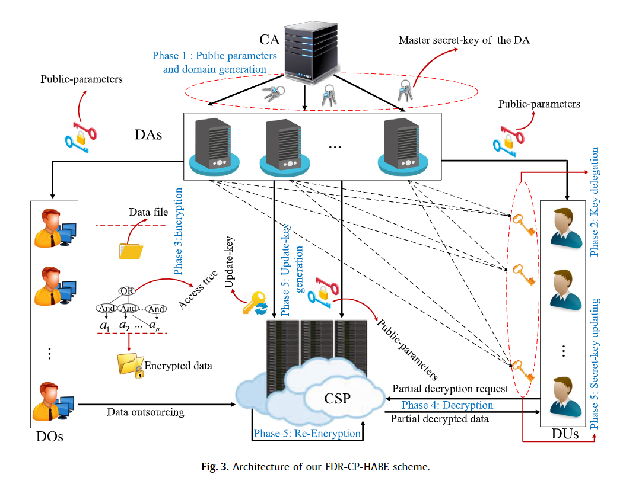

Slide 19
CP-HABE system consists of the following five phases
System Setup (Phase 1): CA 執行此步驟，他負責初始化系統的public parameters 和DAs的master secret-keys。
Key delegation (Phase 2): DU加入系統中並且選定一個unique identifier，再根據自身的attributes從DAs那邊獲取對應的secret-keys。
Encryption (Phase 3): DOs 執行此步驟，他們先定義一個access control policy再根據它去加密他們的data.最後再outsource到CSP。
Decryption (Phase 4): DUs將在CSP中的加密data用在Phase 2中得到的secret-keys解密。
User revocation (Phase 5): This phase can be divided into three parts:
Part 1: 當一個DU失去了一個attribute, DAs 更新跟此attribute有關的系統參數，接著DAs生成一把update-key並將它交給CSP。
Part 2: DAs 更新和此attribute有關的DUs的secret-keys。
Part 3: CSP 利用DAs在Part 1生成的update-key去re-encrypt跟此attribute有關的ciphertexts。

Slide 20
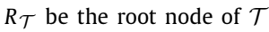
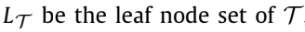
Access tree
Access trees are convenient to represent access policies
In an access tree :
leaf nodes are associated with a set of attributes
any inner node represents a threshold value
:
is the leaf node associated with an attribute a

Slide 21
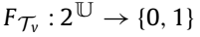
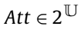
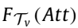
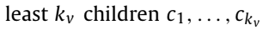
Access tree
Let be the universal attribute set, and let be an access tree. For a node in , consider a function that for any attribute set the evaluation of is performed as follows:

Slide 22
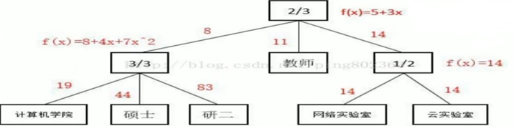
Access tree

Slide 23
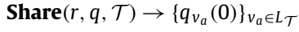

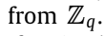
Share
:

Slide 24
Combine

Slide 25
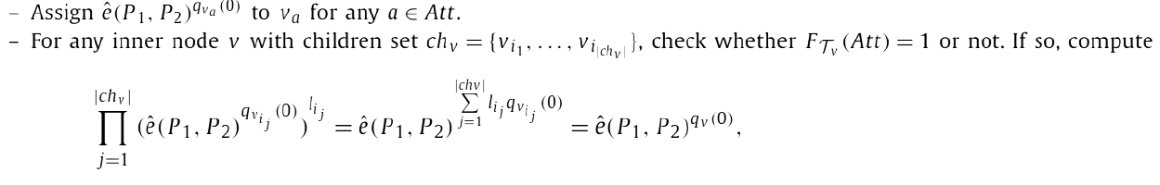
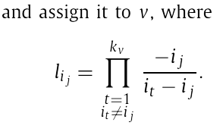
Combine

Slide 26
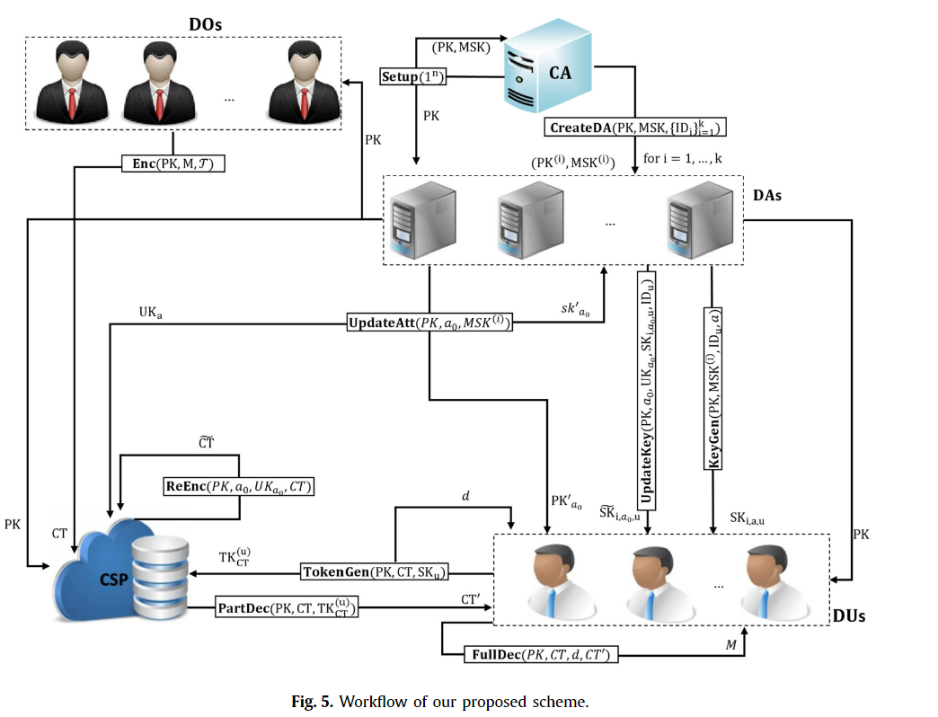

Slide 27
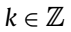

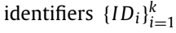
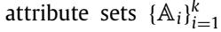
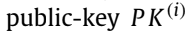
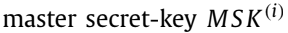
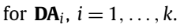
Definition of FDR-CP-HABE system
:
由CA執行
Input : 安全參數n以及universal attribute set
Output : global public parameters PK 以及master secret-key MSK
由CA執行
，new domain authorities
Input : PK、MSK、 、
Output : ， ，

Slide 28
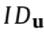
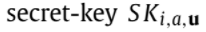
Definition of FDR-CP-HABE system
由 執行
Input : the identifier of the DU, attribute a
Output :
由 DO 執行
Input :
Output :

Slide 29
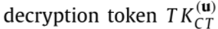
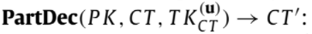
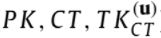
Definition of FDR-CP-HABE system
由DU執行
Input : secret-key set of the DU
Output : , associated private-key d
由CSP執行
Input :
Output :

Slide 30
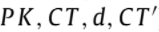
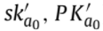
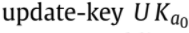
Definition of FDR-CP-HABE system
由DU執行
Input :
Output :
由 執行
Input : 要撤銷的
Output : 更新跟 有關的參數 ,

Slide 31
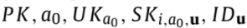
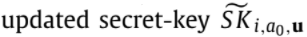
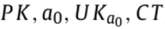
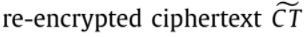
Definition of FDR-CP-HABE system
由DAs執行
Input :
Output :
由CSP執行
Input :
Output :

Slide 32
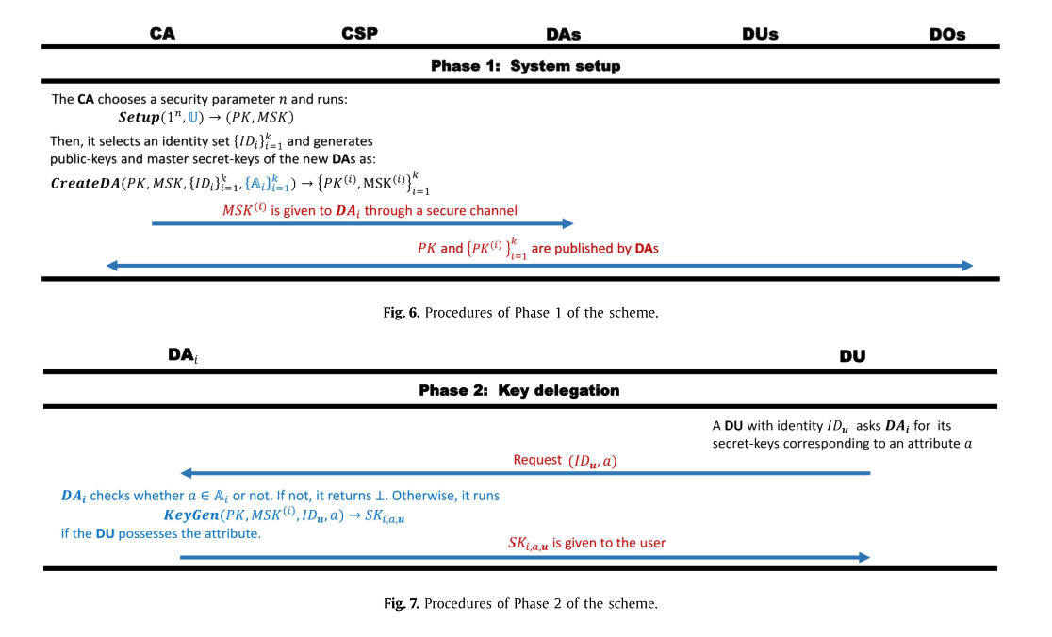

Slide 33
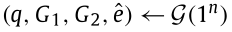
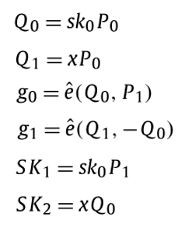
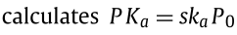
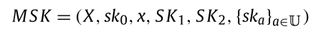
System setup
runs
randomly
output

Slide 34
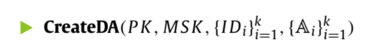
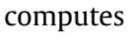
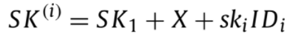
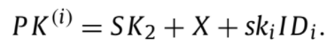
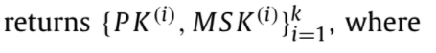
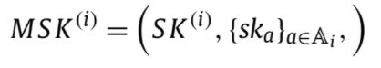
System setup
當大量DUs要 的key之請求過多現有DUs無法負荷時，CA可以new擁有 的新DU。，

Slide 35
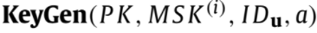



Key delegation
,
else

Slide 36


Slide 37


Encryption
Output

Slide 38




Decryption
Output

Slide 39






Decryption

Slide 40


Slide 41




Decryption
Decrypts

Slide 42


Slide 43




User revocation

Slide 44



User revocation
compute

Slide 45
User revocation
compute

Slide 46



Performance analysis

Slide 47

Performance analysis

Slide 48
Conclusion
Their scheme offers a high level of flexibility and scalability in key delegation and user revocation mechanisms.
Efficient and offers lightweight computing in the decryption phase.
Semantically secure in the standard model based on the hardness assumption of the DBDH problem.
Achieves fine-grained data access control over the outsourced ciphertexts,
Resistant against the collusion attack of unauthorized data users.

Slide 49


Slide 50

Decryption only by DU

Slide 51


Slide 52


Slide 53


